Slide 1
UMD DOTS By - Avinav Dixit, Kumar Saket

Slide 2


Slide 3
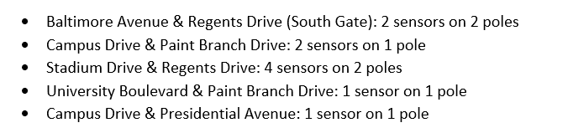
Coverage Area

Slide 4
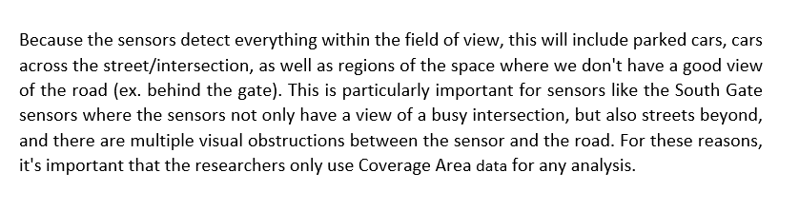
Coverage Area
Reply by Numina :

Slide 5
Data Summary

Slide 6
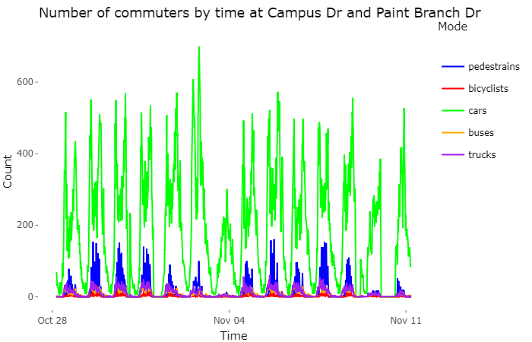
Visualization (Mode of Conveyance)
Due to Soccer Game Day
Highest no. of cars than any location since it is entry point to UMD
Notes:
Highest number of cars than any location, as it is entry point to UMD. Most of the people go to their offices via M-Circle.

Slide 7
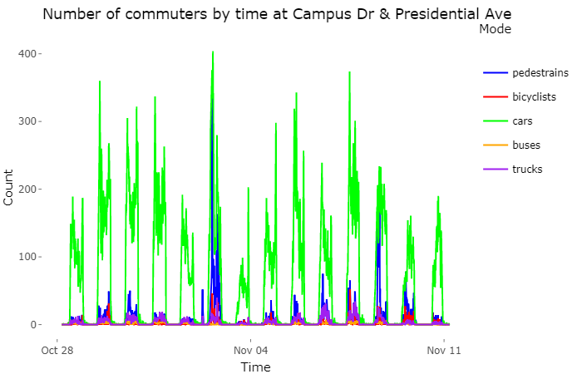
Visualization (Mode of Conveyance)
Due to Soccer Game Day & proximity to Ludwig Field
Notes:
UMD Homecoming & Soccer Game Both

Slide 8
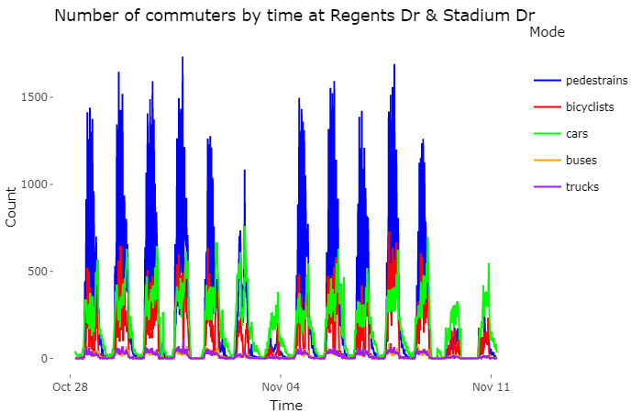
Visualization (Mode of Conveyance)
Similar trend across two weeks
Notes:
Highest number of pedestrians between all locations, explained by the garage.

Slide 9
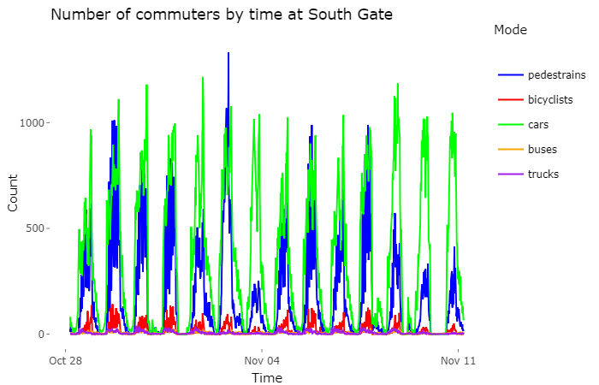
Visualization (Mode of Conveyance)
Peak due to UMD Homecoming Celebration
Notes:
Homecoming event on 3rd Nov, huge number of people for attending event at Cornerstone

Slide 10
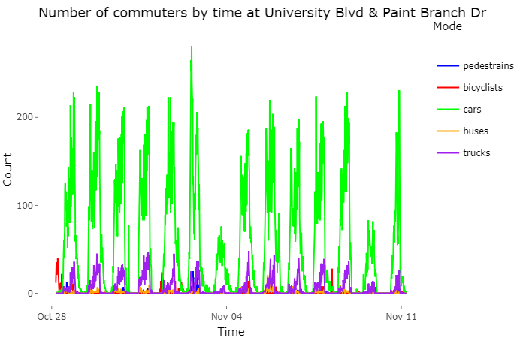
Visualization (Mode of Conveyance)
Similar trend across two weeks
Notes:
Highest number of trucks of all locations because of the proximity with the freeway

Slide 11
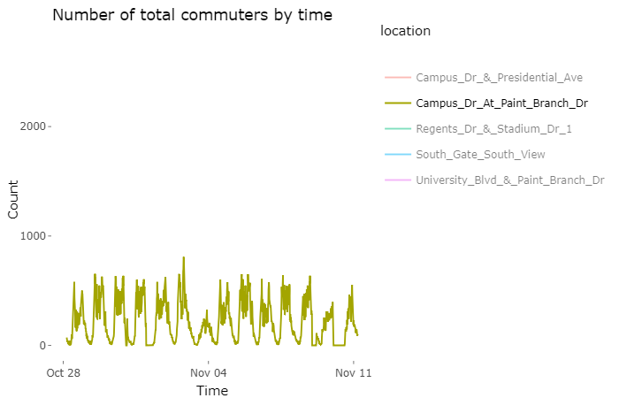
Visualization (Temporal Dynamic)

Slide 12
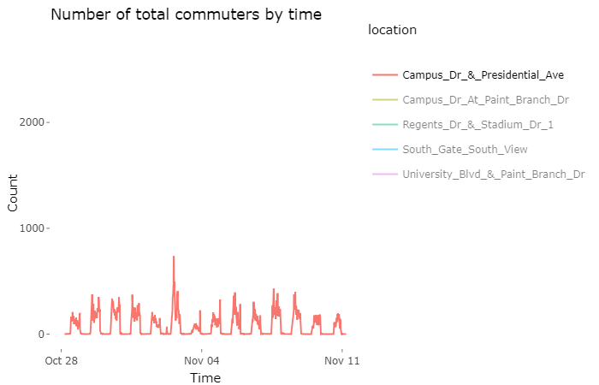
Visualization (Temporal Dynamic)

Slide 13
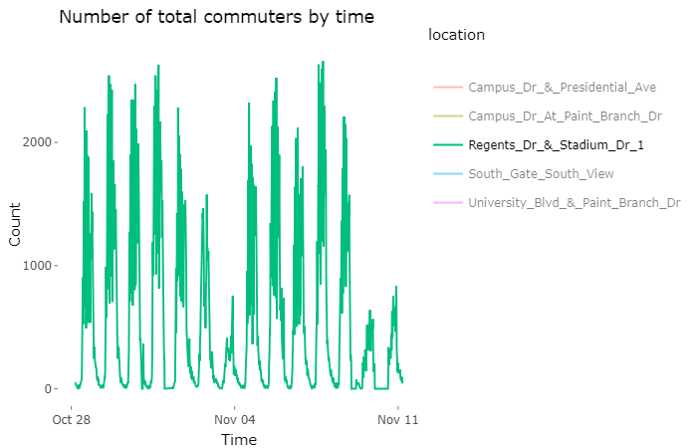
Visualization (Temporal Dynamic)

Slide 14
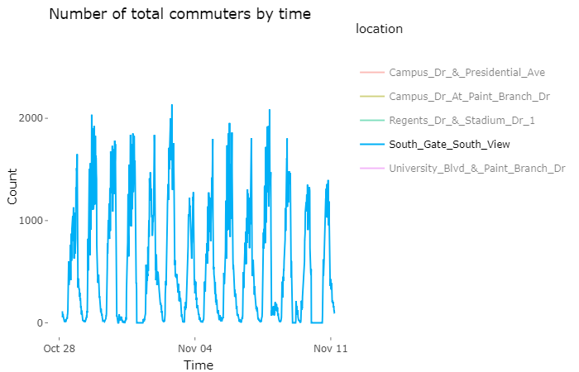
Visualization (Temporal Dynamic)

Slide 15
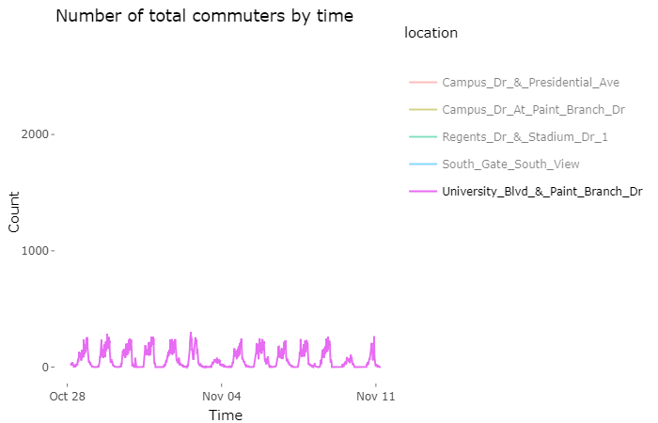
Visualization (Temporal Dynamic)

Slide 16
Predictive Model

Slide 17
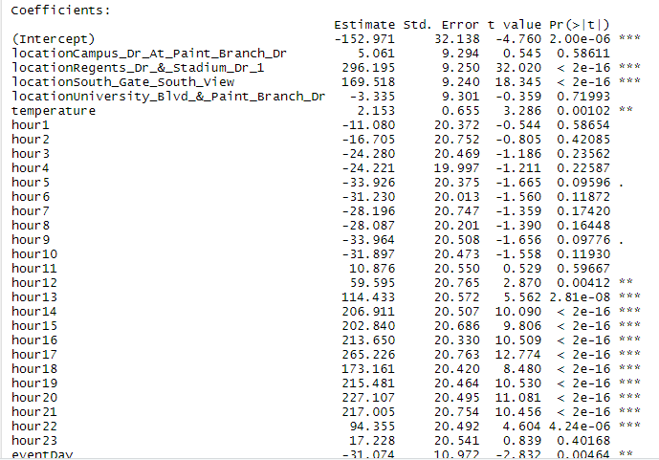
Non-vehicular traffic

Slide 18
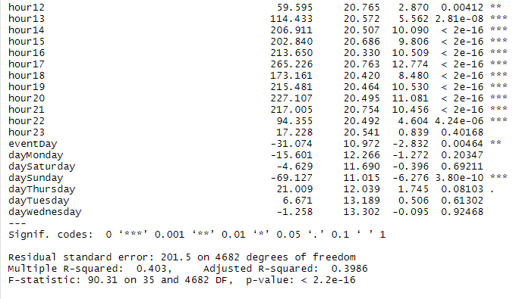
Non-vehicular traffic

Slide 19
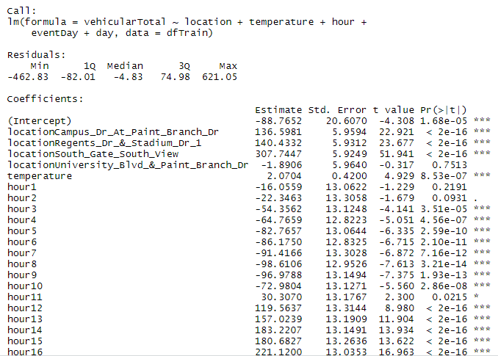
Vehicular traffic

Slide 20
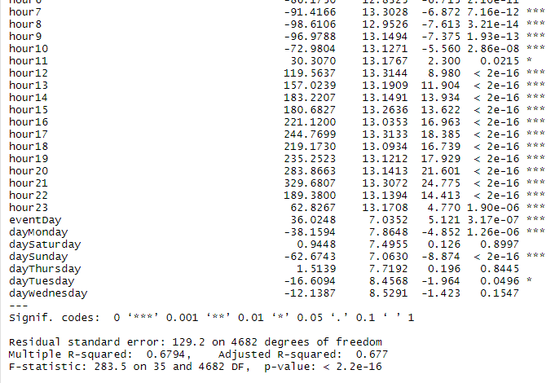
Vehicular traffic

Slide 21
Inferences
Two types of traffic
Plan events considering other variables
Insufficient data for temperature
Reroute vehicles
Limiting permitted radius on event days; Temporary Parking and coordinated shuttles

Slide 22
Thank You

